Slide 1
DATA Analysis PROJECT
- AYISHA AFNAN

Slide 2

Agenda
INDRODUCTION
EXCEL
POWER BI
TABLEAU
CONCLUSION

Slide 3
INTRODUCTION
In today’s data-driven world, effective visualization is essential for turning complex data into clear insights. This project explores three tools — Excel, Power BI, and Tableau — each demonstrating unique capabilities in data analysis and dashboard creation. Together, they show how raw data can be transformed into interactive and actionable insights for informed decision-making

Slide 4
Excel dashboard
Food panda Online Delivery Platform

Slide 5
Dataset description
In this dataset, we have various parameters related to food panda customer and restaurant data, such as : customer ID, gender, and age group , city and restaurant name, dish name and category, quantity and price, payment method and order date, order frequency, delivery status, rating, and loyalty points
This data was used to analyze customer behavior, restaurant performance, and sales trends across different time periods and cities.
By using Pivot Tables and create Pivot Charts.

Slide 6
Charts Used in Dashboard
KPI cards: display total amount and total loyalty points
Bar chart: shows average rating by restaurants and also represents order distribution by churn status (active vs inactive)
Doughnut chart: displays age group vs number of customers
Column chart: represents order frequency by month
Stacked bar chart: shows food preference distribution across major cities
Line chart: displays payment method trends
Pie chart: shows delivery status (delivered, delayed, cancelled)
Slicers: used for filtering by year and month across all visuals

Slide 7
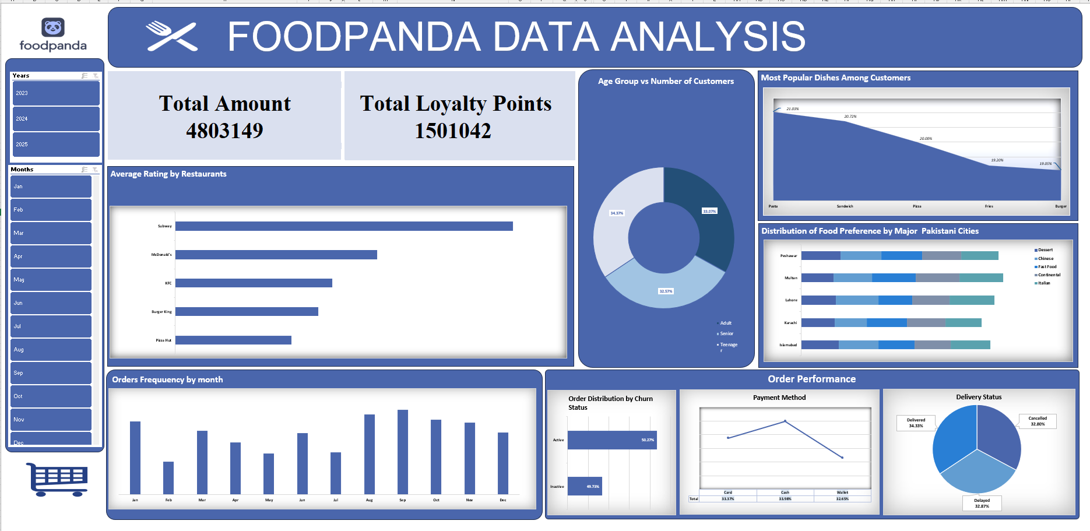
summary
The excel dashboard for food panda data provides a comprehensive view of sales, customer demographics, and restaurant performance. By visualizing key metrics such as order trends, ratings, and delivery status, the dashboard helps identify areas for improving customer satisfaction and business efficiency. Its interactive design makes it an effective tool for tracking performance, understanding customer behavior, and supporting data-driven decision-making.

Slide 8
Power bi dashboard
Global Student Migration (2019-2023)

Slide 9
Dataset description
In this dataset, we have various parameters related to global student migration such as student ID, origin country, destination country, university name, course name, field of study, year of enrollment, GPA/score, scholarship received, placement status, placement country, starting salary, and visa type.
This data was used to analyze international student mobility, academic performance, course preferences, etc, between 2019 and 2023.
By using Power BI, different charts and visualizations were created.

Slide 10
Charts Used in Dashboard
Cards / KPIs: Display key performance metrics such as Total Students (5K) and Average GPA/Score (3.33).
Donut Chart: Visualizes the Top 5 Demanded Courses based on student enrollment.
Horizontal Bar Chart: Shows student distribution across the Most Demanded Fields of Study.
Vertical Column Chart: Depicts the Yearly Trend of Course Enrollment (Data Science) from 2019–2023.
Map plot: Represents the Destination Country by Student Count, with bubble size indicating student volume.
Dual-Axis Line Chart: Compares Placement Rate (%) and Scholarship Rate (%) across various Fields of Study.
Slicers / Filters: Enhance interactivity, allowing users to filter insights by Year of Enrollment and Destination Country.

Slide 11
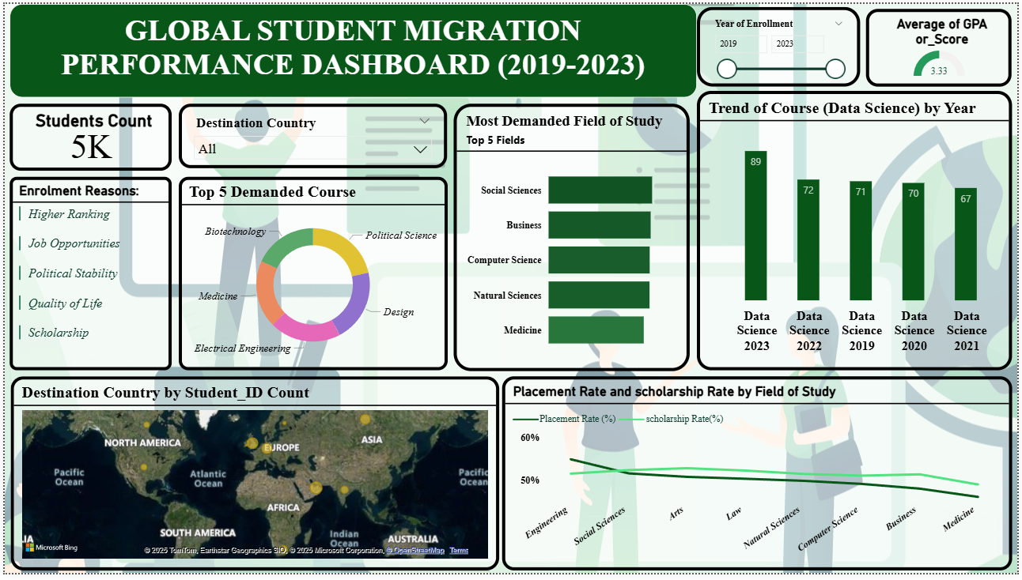
summary
The Power BI dashboard for Global Student Migration (2019–2023) data provides a clear and interactive overview of international student trends. It showcases the growing demand for Data Science and highlights Social Sciences as a leading field of study. By visualizing placement and scholarship rates across disciplines, the dashboard uncovers key patterns between academic performance and career outcomes. Its interactive design makes it a valuable tool for educational institutions, policymakers, and students, helping them explore global education trends, migration motivations, and post-study opportunities, etc.

Slide 12
Tableau dashboard
BMW Sales (2010-2024)

Slide 13
Dataset description
This dashboard presents a comprehensive analysis of BMW’s global sales performance from 2010 to 2024, providing insights into overall sales trends, revenue growth, regional performance, and product characteristics.
The dataset covers key indicators such as total sales units (50,000) and total revenue ($3.752 million), along with detailed breakdowns by region (Asia, Europe, north America, middle east, Africa, South America), color popularity, fuel type (petrol, diesel, hybrid, electric), and sales classification (high/low).
It also examines the relationship between price and mileage across major BMW models including 3 series, 5 series, 7 series, i3, m3, m5, x3, x5, and x6, while the sales trend over time chart provides a clear view of market dynamics across the 15-years period.

Slide 14
Charts Used in Dashboard
Cards / KPIs: Display key metrics such as Total Sales Units (50,000) and Total Revenue ($3.752M).
Vertical Bar Chart: Shows Regional Sales Performance across six major global regions.
Horizontal Bar Chart: Illustrates Color Popularity, highlighting customer preferences for colors like Red, Silver, White, Grey, Blue, and Black.
Donut Chart: Depicts Fuel Type Analysis, showing revenue contribution by fuel type (Petrol, Diesel, Hybrid, Electric).
Pie Chart: Represents Sales Classification, comparing the percentage of High (39.49%) and Low (60.51%) sales.
Clustered Bar/Column Chart: Shows the Price vs Mileage Comparison for different BMW models.
Line Chart: Displays the Sales Trend Over Time (2010–2024) to visualize growth and fluctuations.
Table / Matrix: Summarizes data by Transmission Type (Automatic vs Manual), including Average Engine Size, Average Mileage, and Average Price.
Slicer / Filter: Enables users to filter by BMW Model for focused analysis.

Slide 15
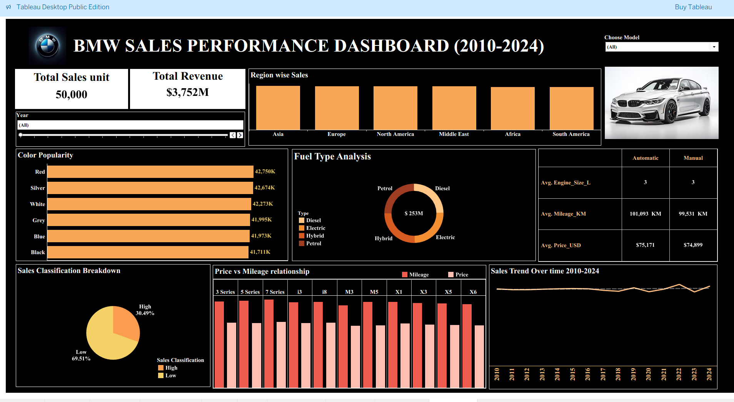
summary
The tableau dashboard for BMW sales (2010–2024) data presents an in-depth analysis of BMW’s global sales over 15 years. It highlights strong performance in north America and Europe, identifies red as the most preferred color, and shows petrol and diesel as major revenue drivers. By visualizing sales trends, price-to-mileage comparisons, and model performance, the dashboard offers actionable insights into customer preferences, market dynamics, and product efficiency. Its interactive design helps sales teams, analysts, and strategists make data-driven decisions to strengthen BMW’s market position.

Slide 16
conclusion
In conclusion, this project highlights the importance of data visualization in transforming complex datasets into meaningful insights. Using Excel, Power BI, and Tableau, we analyzed three distinct domains—Food panda customer and restaurant data, Global Student Migration trends, and BMW Sales performance. Each tool offered unique analytical strengths, enabling effective exploration of customer behavior, international education patterns, and automotive market trends. Collectively, these visualizations demonstrate how data-driven dashboards support informed decision-making, performance evaluation, and strategic growth across diverse industries.

Slide 17
Thank you

